Slide 1
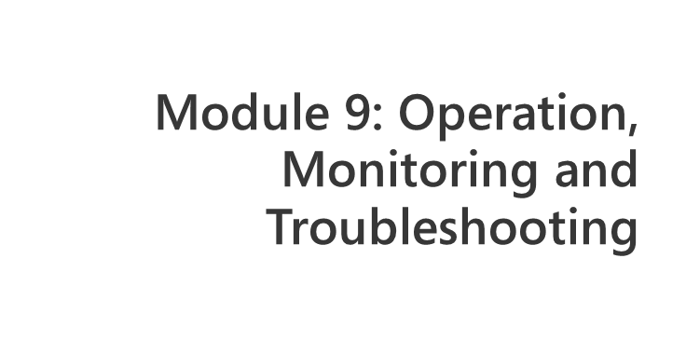
Notes:
Module x: Title
Course xxxxy
Presentation: xx minutes
Lab: xx minutes
This module helps students to ….
After completing this module, students will be able to:
Objective #1.
Objective #2.
Objective #3.
Required materials
To teach this module, you need the Microsoft Office PowerPoint® file xxxxy_xx.ppt.
Important It is recommended that you use PowerPoint 2002 or a later version to display the slides for this course. If you use PowerPoint Viewer or an earlier version of PowerPoint, all the features of the slides might not be displayed correctly.
Preparation tasks
To prepare for this module:
Read all of the materials for this module.
Practice performing the demonstrations and the lab exercises.
Work through the Module Review and Takeaways section and determine how you will use this
section to reinforce student learning and promote knowledge transfer to on-the-job performance.
If this is a KonaH product, use this section:
Make sure that students are aware that there are additional information and resources for the module on the Course Companion CD.
If this is a Forte product, use this section:
Make sure that students are aware that there are additional online resources for the module on the Course CD.

Slide 2
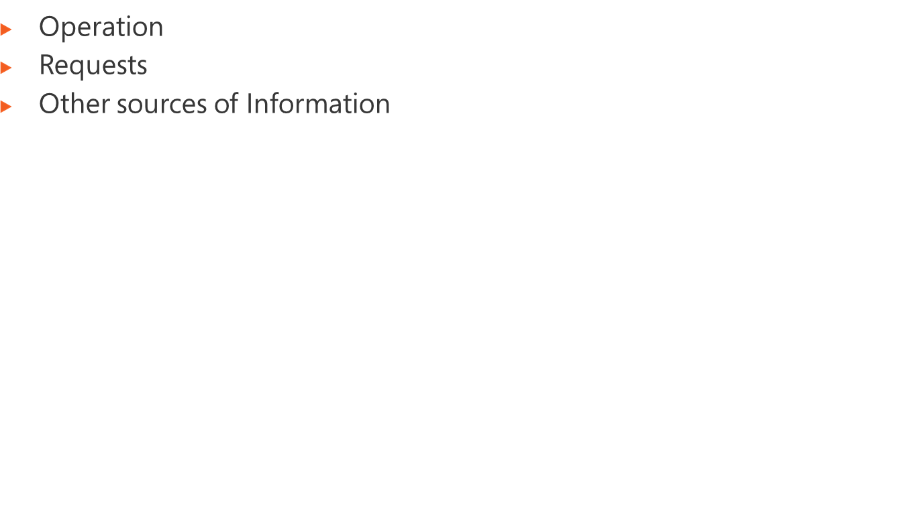
Notes:
Module x: Title
Course xxxxy

Slide 3
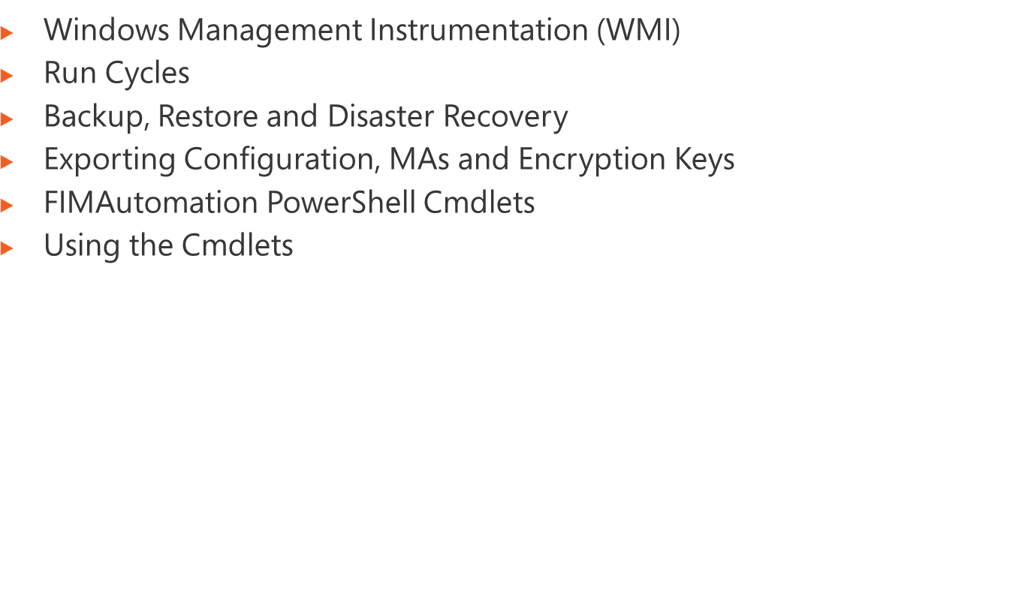
Notes:
Module x: Title
Course xxxxy

Slide 4
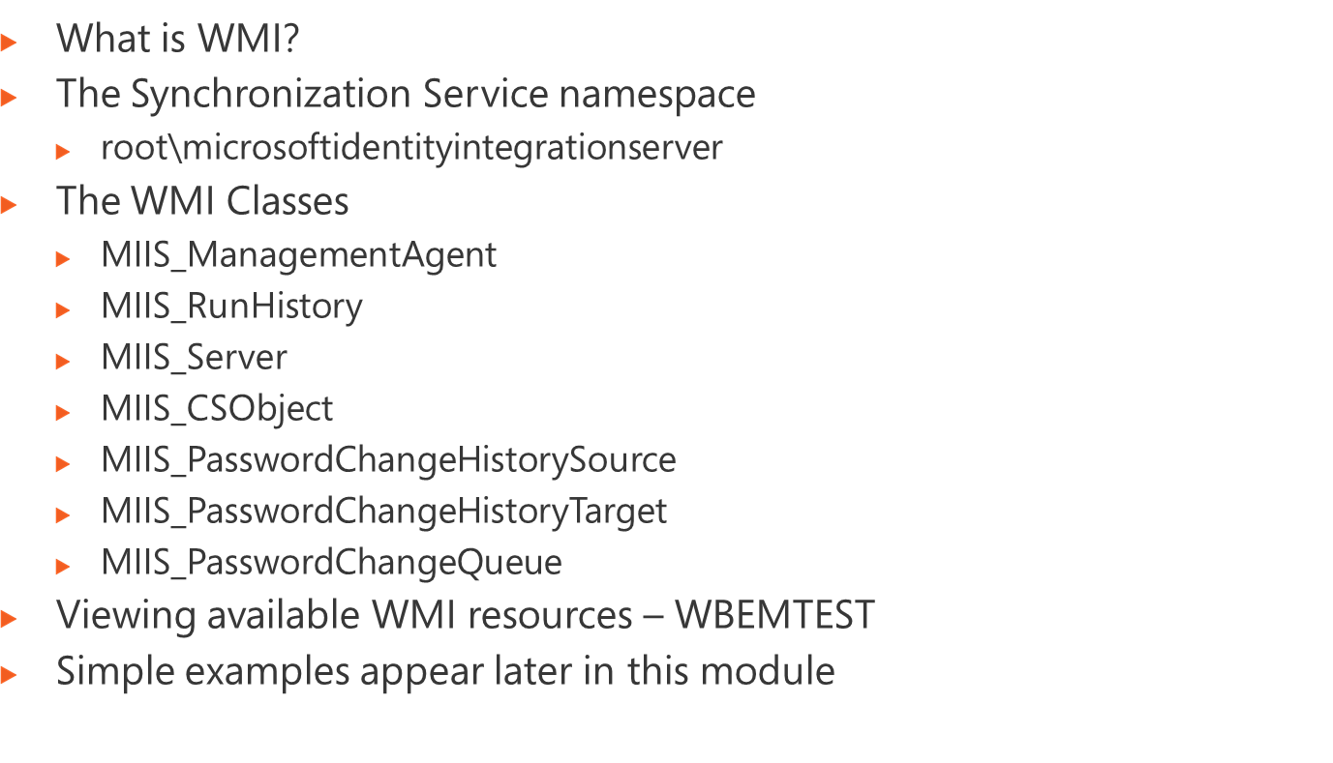
Notes:
Module x: Title
Course xxxxy

Slide 5
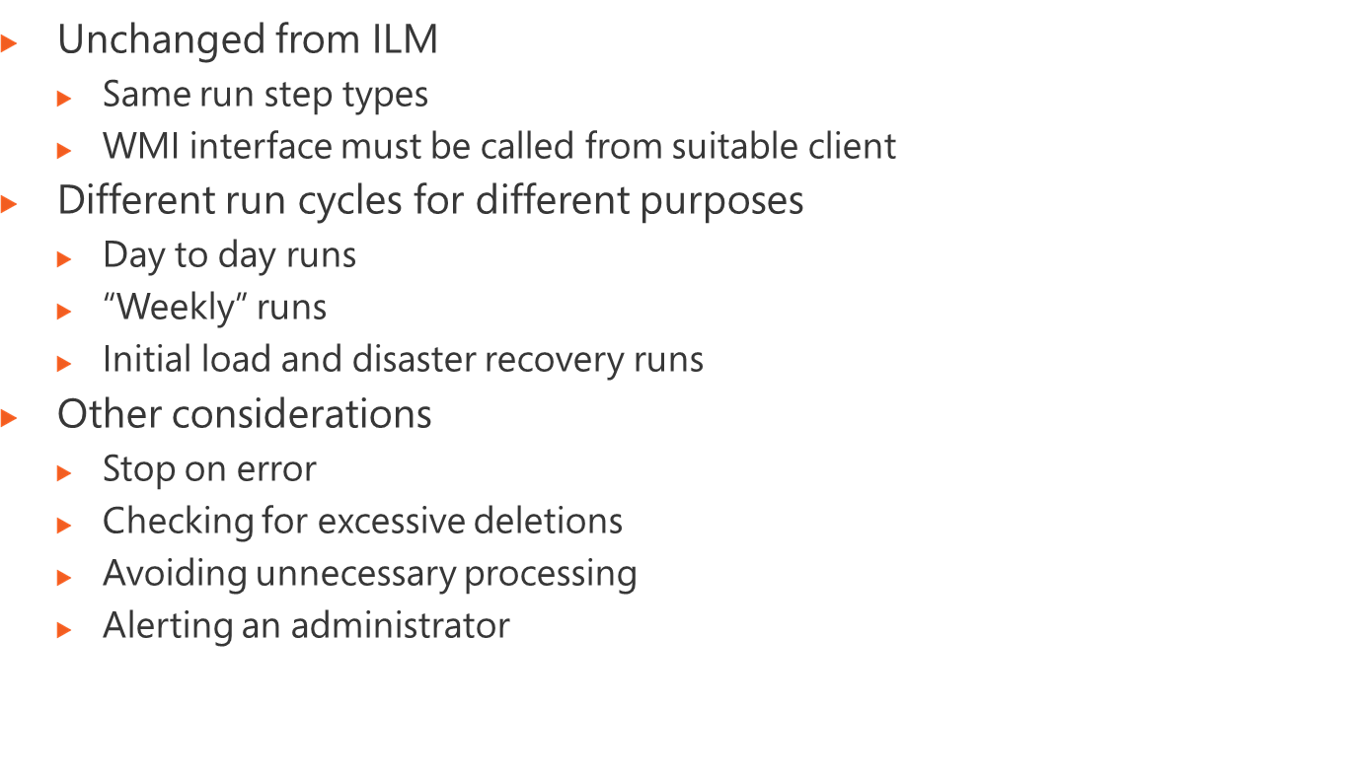
Notes:
Module x: Title
Course xxxxy

Slide 6
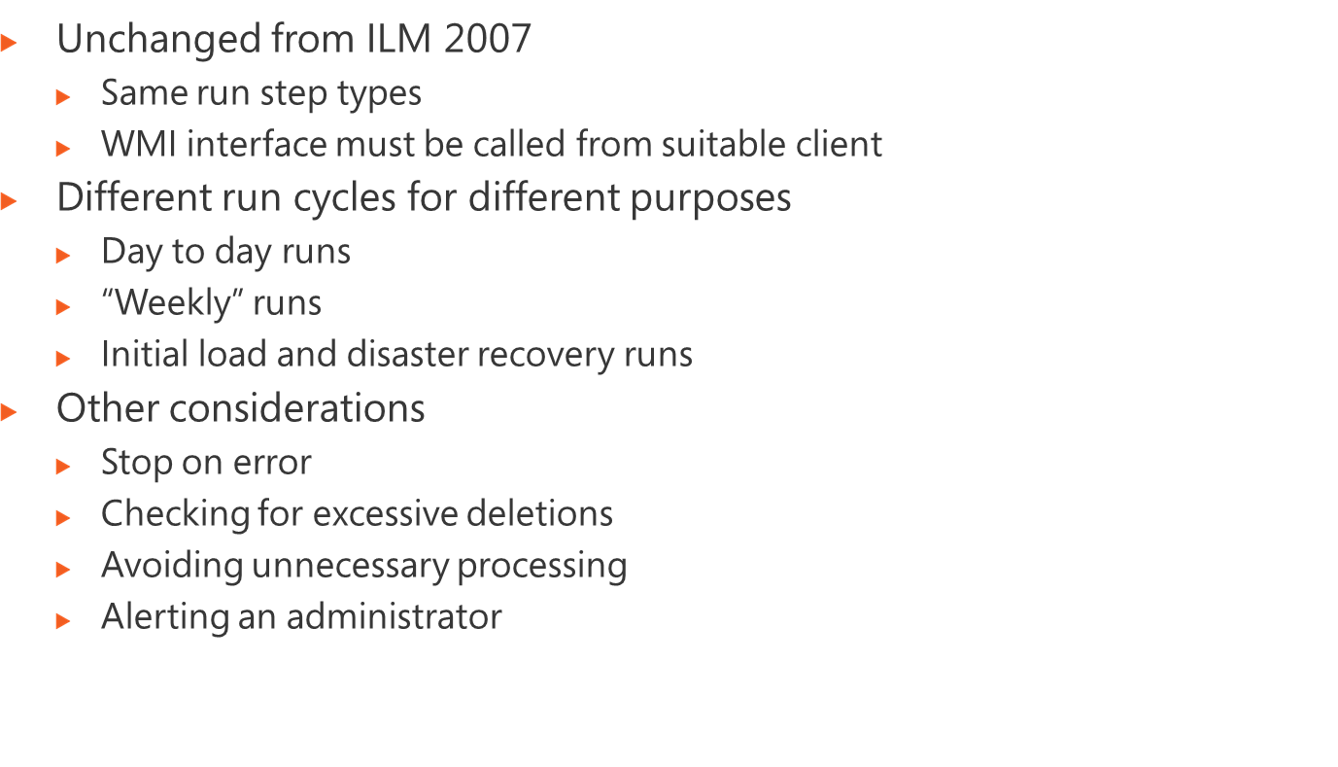
@echo off
REM Perform a full import
cscript FullImport.vbs
if {%errorlevel%} NEQ {0} (echo Error[%errorlevel%]: command file failed) & (goto exit_script)
cscript checkImportDeletions.vbs
if {%errorlevel%} EQU {2} (echo Error[%errorlevel%]: Deletion Ratio Hit - aborting batch) & (goto exit_script)
if {%errorlevel%} NEQ {0} (echo Error[%errorlevel%]: command file failed) & (goto exit_script)
cscript DeltaSynch.vbs
if {%errorlevel%} NEQ {0} (echo Error[%errorlevel%]: command file failed) & (goto exit_script)
REM More commands to perform exports on other systems
:exit_script
@ECHO off
SET logfile="C:\SyncScripts\Sync.log"
del /q %logfile% 2> NUL
: Start
ECHO Running Sync Script at %Time% >> %logfile%
ECHO. >> %logfile%
cscript //nologo C:\SyncScripts\SyncFIM.vbs
ECHO.
ECHO Time %Time%
ECHO Sleeping for one minute
ECHO.
timeout /t 60
goto Start
Set Service = GetObject("winmgmts:{authenticationLevel=PktPrivacy}!
root/MicrosoftIdentityIntegrationServer")
Set Server = Service.Get("MIIS_Server.Name='MIIS_Server'")
Wscript.Echo "Clearing run history..."
DeleteDate = DateAdd("d",-2,Now())
DeleteDate = Right("0000" & Year(DeleteDate),4) & "-" & Right("00" &
Month(DeleteDate),2) & "-" & Right("00" & Day(DeleteDate),2)
Server.ClearRuns(DeleteDate)
Set MASet = Service.ExecQuery("select * from MIIS_ManagementAgent where Name = 'HR'")
for each MA in MASet
Wscript.Echo "Syncing HR Data ..."
MA.Execute("Export")
MA.Execute("Full Import")
MA.Execute("Delta Sync")
Next
Set MASet = Service.ExecQuery("select * from MIIS_ManagementAgent where Name = 'FIM'")
for each MA in MASet
dim managementagent
dim ratio
dim result
ratio = 5
Set wmiService = GetObject("winmgmts:{authenticationLevel=PktPrivacy}!
root/MicrosoftIdentityIntegrationServer")
Set managementagent = wmiService.Get( "MIIS_ManagementAgent.Name='HR'")
result = managementagent.NumImportDelete / managementagent.NumCSObjects * 100
if result >= ratio then
WScript.Echo "%ATTENTION: Ratio is hit. Setting errorlevel to 2"
Wscript.quit(2)
end if
WScript.Echo "%Success: Ratio is not hit"
Wscript.quit(0)
Notes:
Module x: Title
Course xxxxy

Slide 7
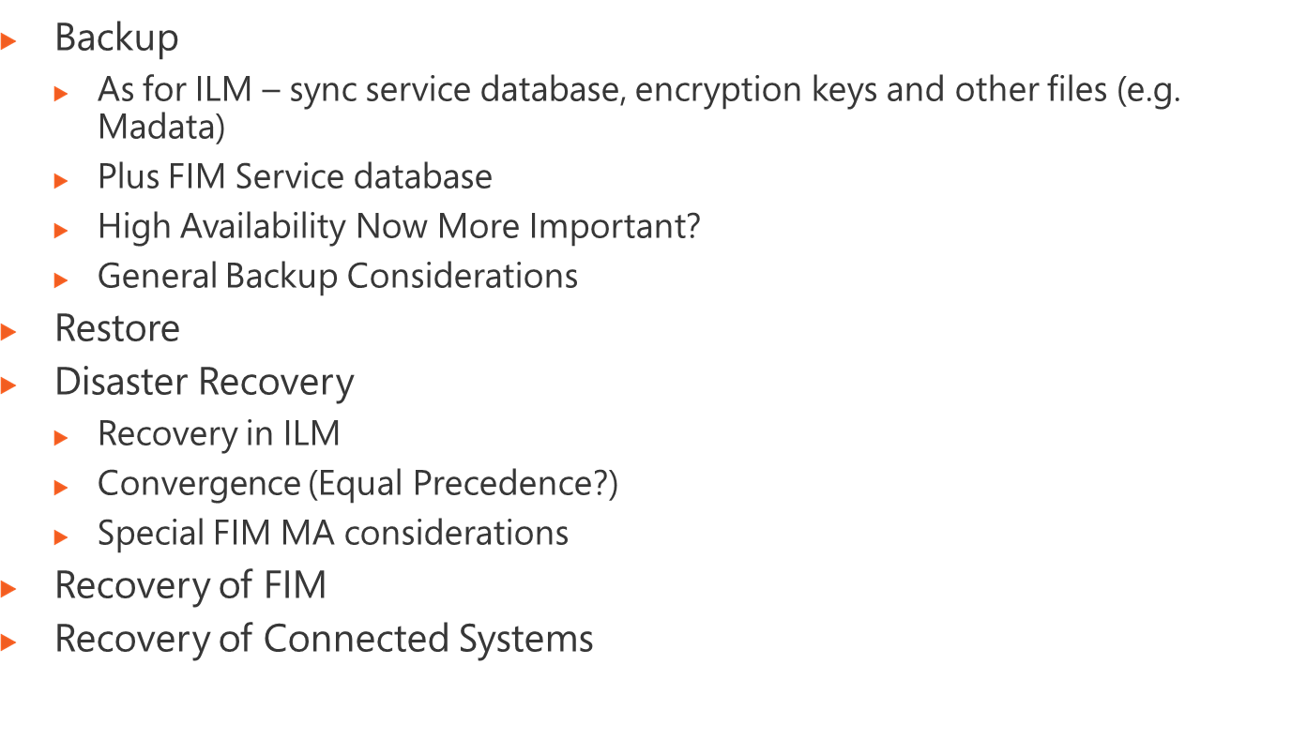
Notes:
Module x: Title
Course xxxxy

Slide 8
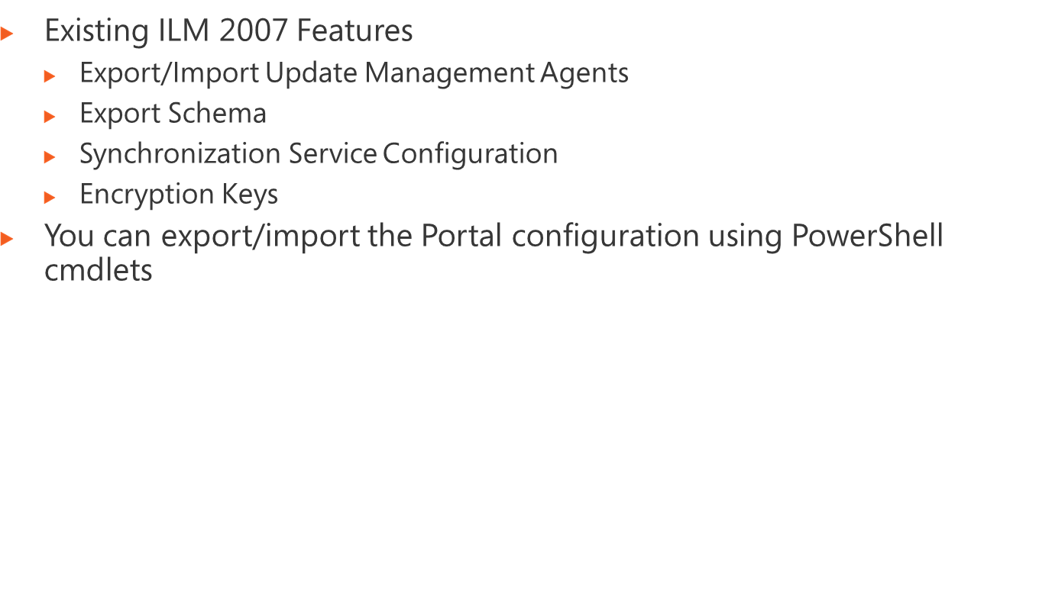
Notes:
Module x: Title
Course xxxxy

Slide 9
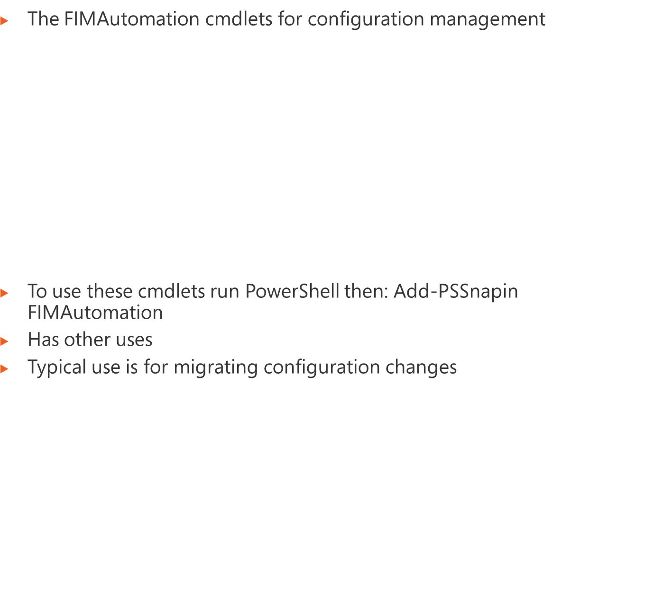
Command | Purpose
Export-FIMConfig | to export objects
ConvertFrom-FIMResource | to write the exported data to an XML file
ConvertTo-FIMResource | to load exported data from an XML file
Join-FIMConfig | to match up objects between two exports (to find out what is common between them)
Compare-FIMConfig | To identify the differences
Import-FIMConfig | To import the differences
Notes:
Module x: Title
Course xxxxy

Slide 10
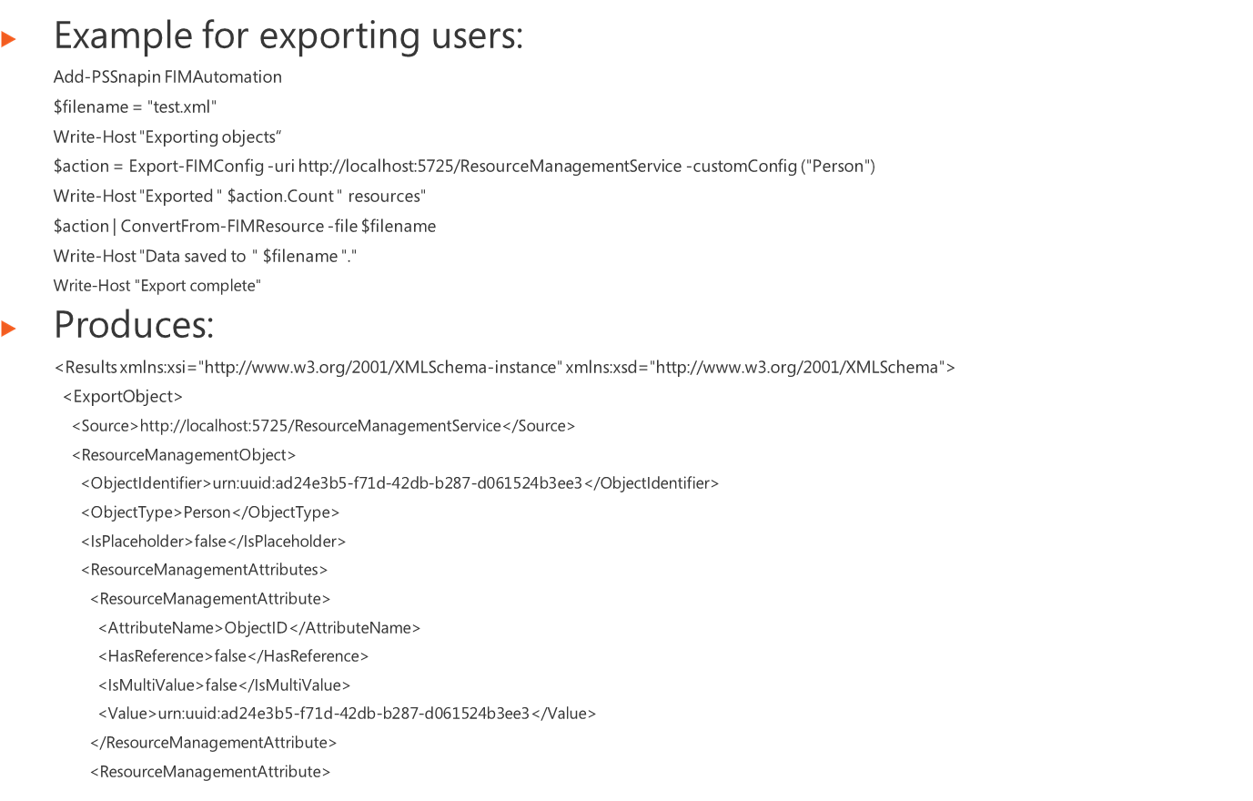
$beforefile = "before.xml"
$afterfile = "after.xml"
$changesfile = "changes.xml"
# We need to specify unique attribute combination in order to match up correct objects
$joinrules = @{
Person = "AccountName Domain";
Group = "AccountName DisplayName";
DomainConfiguration = "DisplayName";
GateRegistration = "ObjectID";
}
Add-PSSnapin FIMAutomation
$before = ConvertTo-FIMResource -file $beforefile
$after = ConvertTo-FIMResource -file $afterfile
# Match up objects (use displayname as join for any objects not specified)
$matches = Join-FIMConfig -source $after -target $before -join $joinrules -defaultJoin DisplayName
$changes = $matches | Compare-FIMConfig
$changes | ConvertFrom-FIMResource -file $changesfile
Notes:
Module x: Title
Course xxxxy

Slide 11
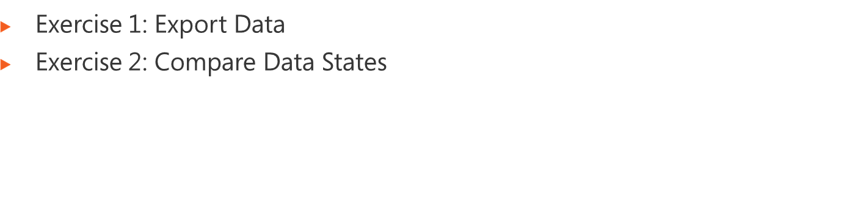
Logon information
Virtual machine | FIM2010RC1
User name | Administrator
Password | Pa$$w0rd
Estimated time: 30 minutes
Notes:
Module x: Title
Course xxxxy
In this lab, students will ….
Exercise 1
In this exercise, students ….
Exercise 2
In this exercise, students ….
Before the students begin the lab, read the scenario associated with each exercise to the class. This will reinforce the broad issue that the students are troubleshooting and will help to facilitate the lab discussion at the end of the module. Remind the students to complete the discussion questions after the last lab exercise.
If this is a KonaH product, use this note:
Note: The lab exercise answer keys are provided on the Course Companion CD. To access the answer key, click the link located at the bottom of the relevant lab exercise page.
If this is a Forte product, use this note:
Note: The lab exercise answer keys are provided on the Course CD.

Slide 12
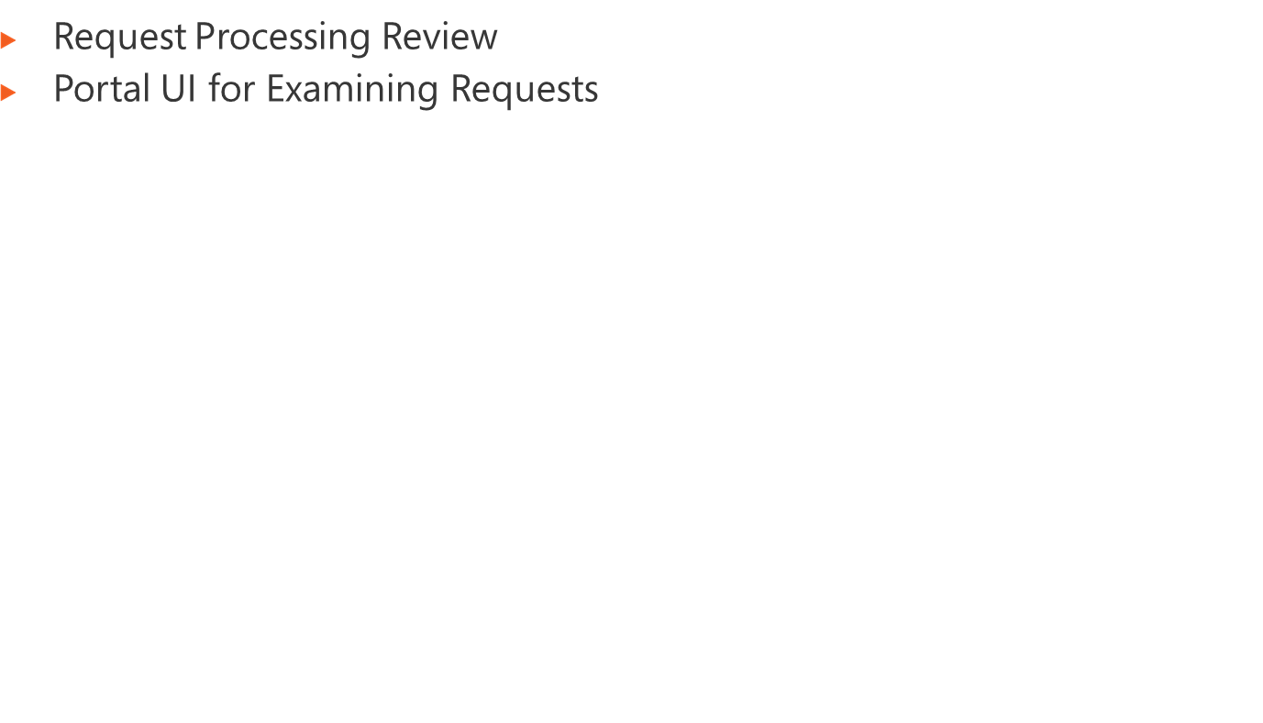
Notes:
Module x: Title
Course xxxxy

Slide 13
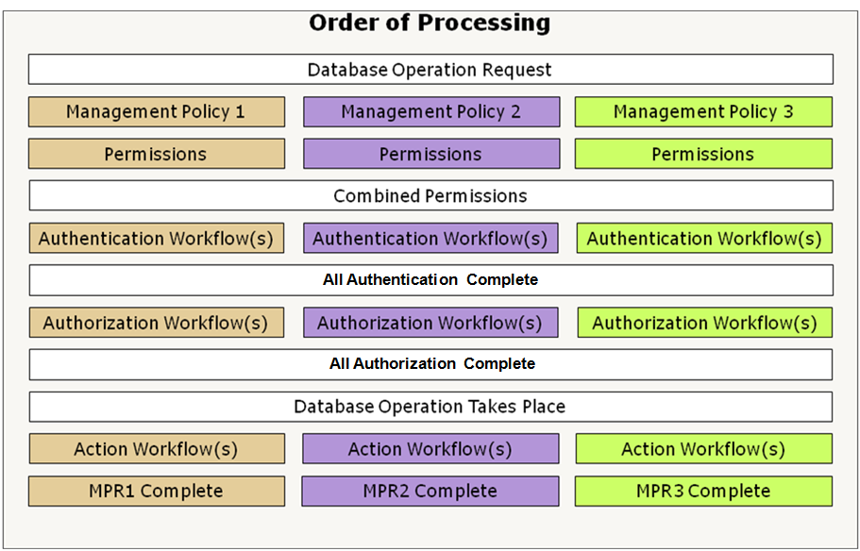
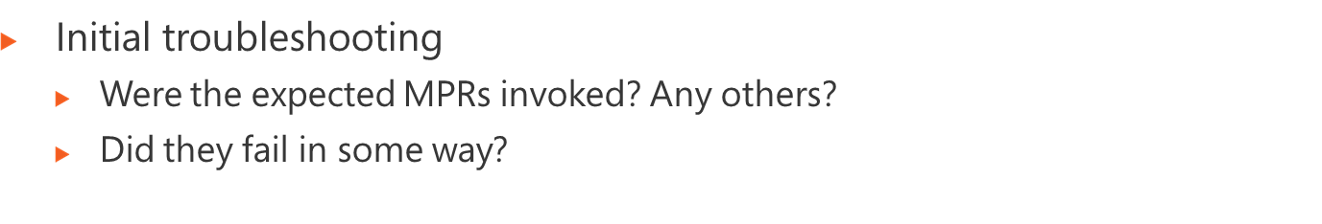
Notes:
Module x: Title
Course xxxxy

Slide 14
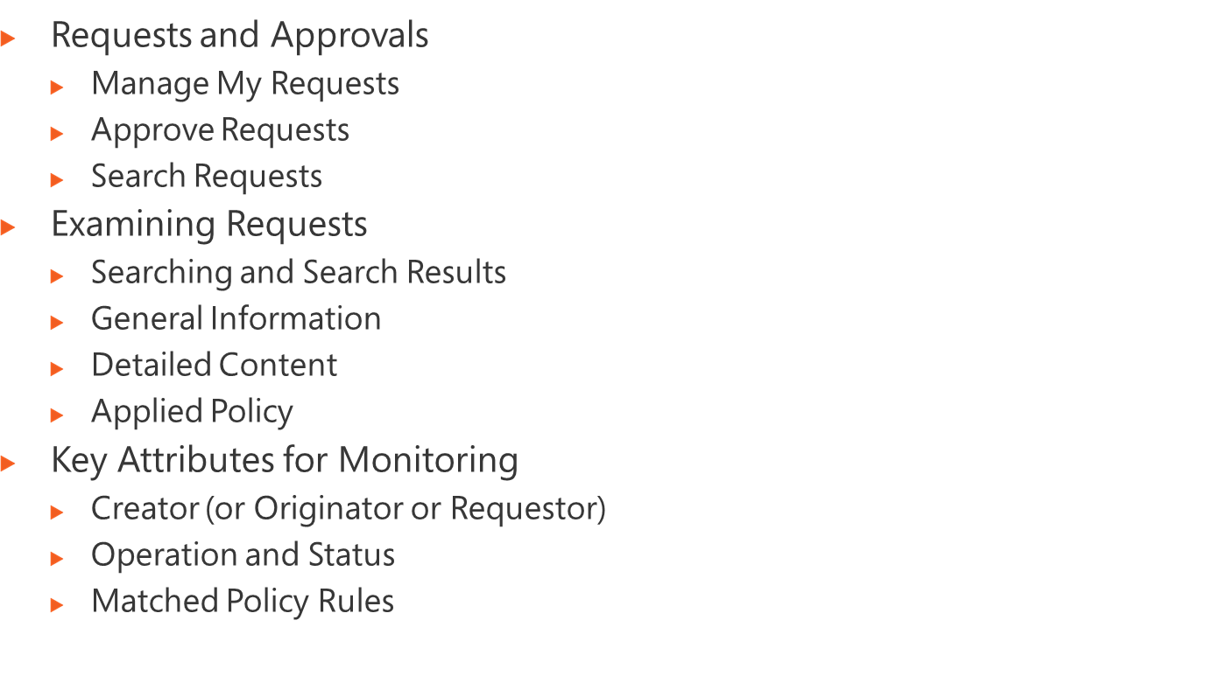
Notes:
Module x: Title
Course xxxxy

Slide 15
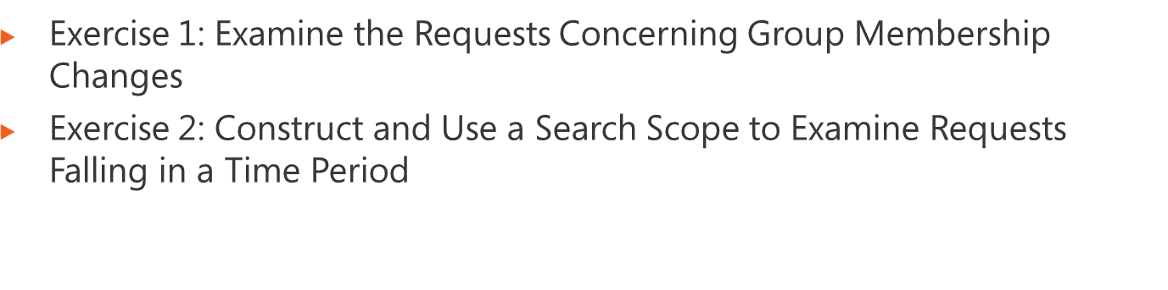
Logon information
Virtual machine | FIM2010RC1
User name | Administrator
Password | Pa$$w0rd
Estimated time: 30 minutes
Notes:
Module x: Title
Course xxxxy
In this lab, students will ….
Exercise 1
In this exercise, students ….
Exercise 2
In this exercise, students ….
Before the students begin the lab, read the scenario associated with each exercise to the class. This will reinforce the broad issue that the students are troubleshooting and will help to facilitate the lab discussion at the end of the module. Remind the students to complete the discussion questions after the last lab exercise.
If this is a KonaH product, use this note:
Note: The lab exercise answer keys are provided on the Course Companion CD. To access the answer key, click the link located at the bottom of the relevant lab exercise page.
If this is a Forte product, use this note:
Note: The lab exercise answer keys are provided on the Course CD.

Slide 16
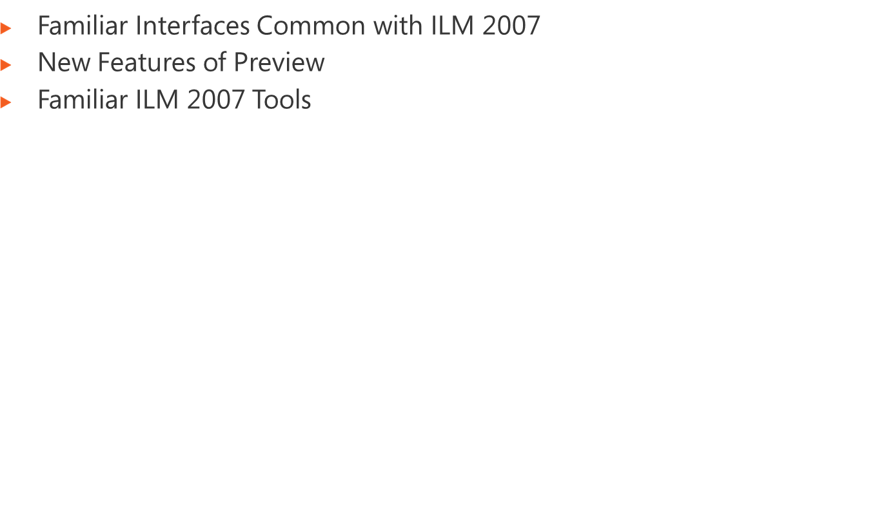
Notes:
Module x: Title
Course xxxxy

Slide 17
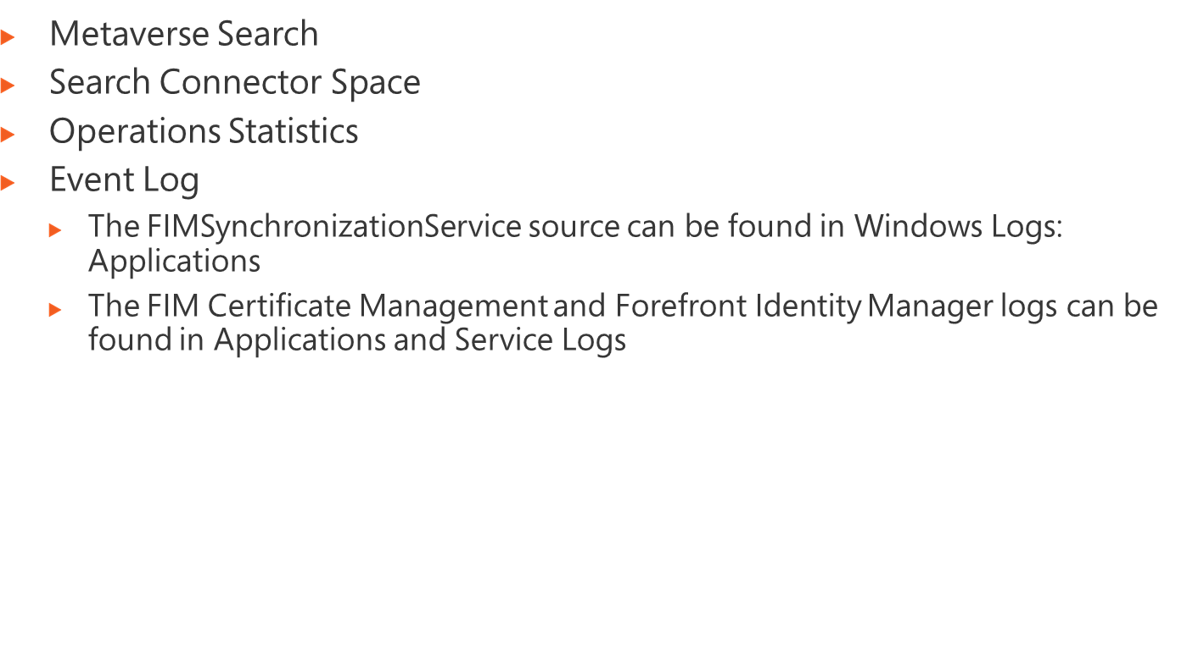
Notes:
Module x: Title
Course xxxxy

Slide 18
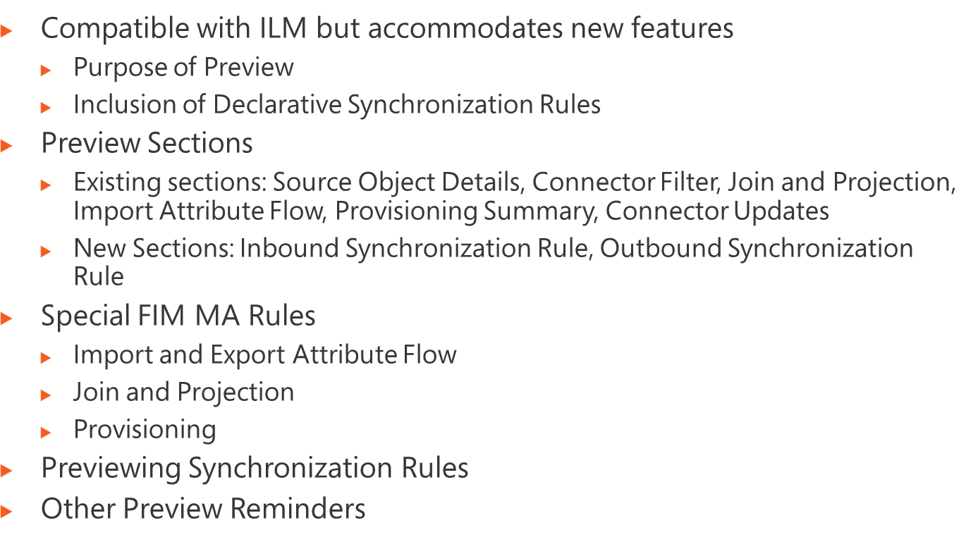
Notes:
Module x: Title
Course xxxxy

Slide 19
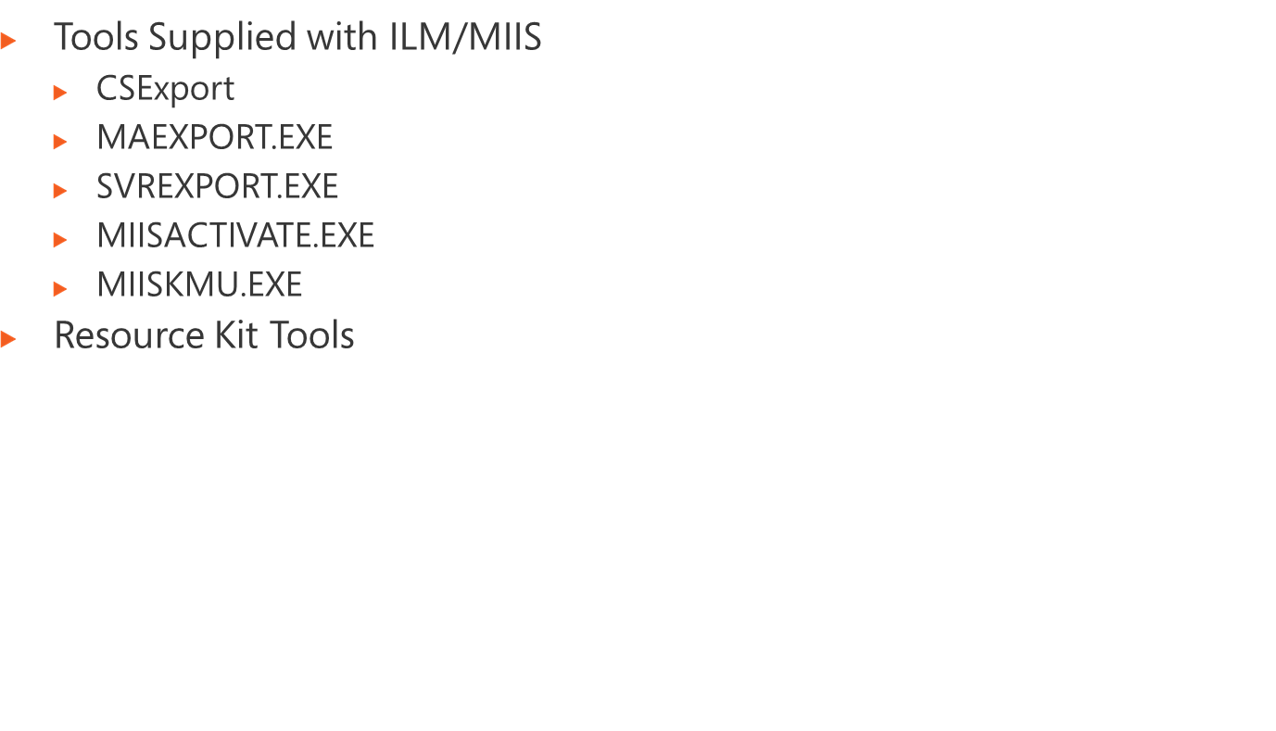
Notes:
Module x: Title
Course xxxxy

Slide 20
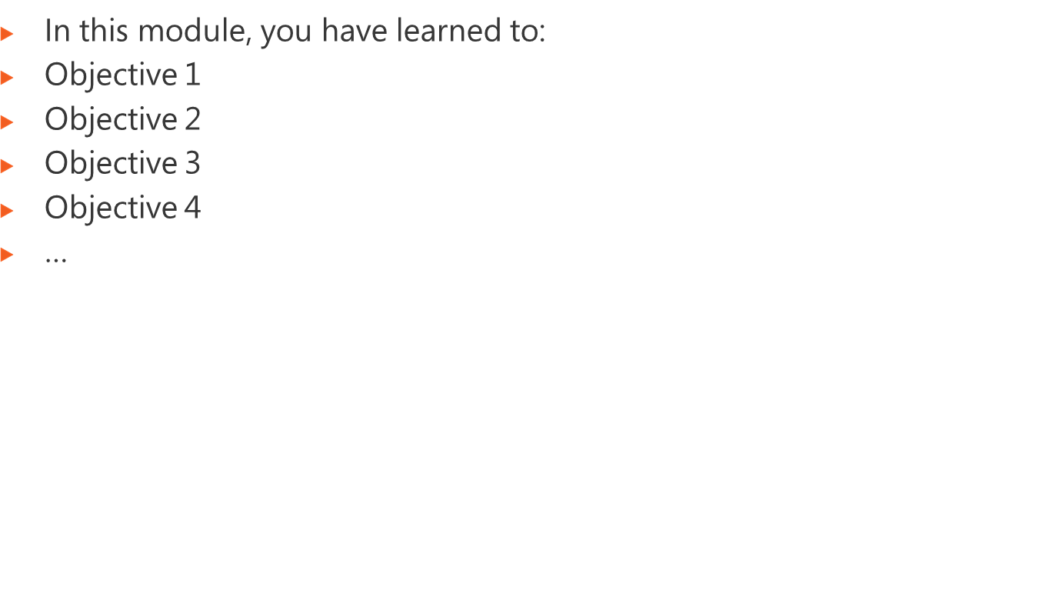
Notes:
Module x: Title
Course xxxxy

